Slide 1

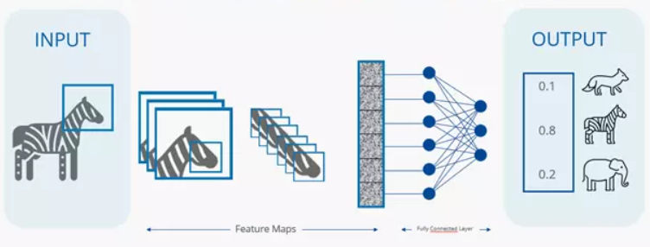
Nail Melanoma Project
Performance Evaluation of CNN Models including other Nail Diseases
Supervisor: Juan Prada
Second Examiner: Thomas Dandekar
Ayca Öztürk, 2777497

Slide 2
CNN Models with the best performances
Vision Transformer ViT-B/16 (has self attention to capture dependencies and relationships within input sequences, learns the global context, good for explainability)
YOLO (new versions have XAI but mostly focused on object detection)
ResNet18 (doesnt have integrated XAI but its an adaptive model which can be used with GradCam, LIME, SHAP)

Slide 3
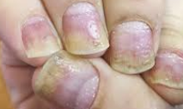
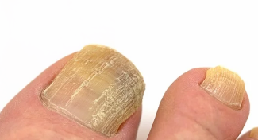
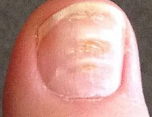
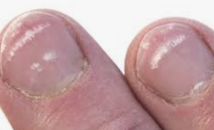
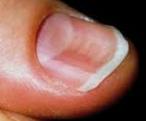
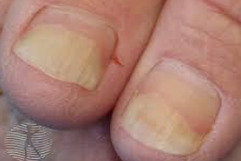
The Most Common Nail Diseases
Nail psoriasis
Beau’s lines
Koilonychia
Onychomycosis
Leukonychia
Onycholysis

Slide 4

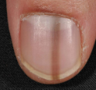
Common Nail Diseases Confused with Nail Melanoma
Subungual hematoma
Melanonychia striata
Onychomycosis
These nail disorders can be included in the training dataset to prevent the model from confusing them with melanoma.

Slide 5
Steps: 1. Dataset Preparation
A new Nail Melanoma dataset from Kaggle was integrated into our existing dataset.
The Bounding Box Algorithm was applied to detect and crop the nails, which were then resized for model input.
The processed images were randomly divided into training, validation, and test sets using a 70–20–10 split.
Additionally, datasets of other common nail diseases were included. The same bounding box, cropping, and resizing procedures were applied.
The final dataset consists of three classes: Healthy, Melanoma, and Other
The Other class includes: Onychomycosis, Leukonychia, Onycholysis, Nail Psoriasis, Beau’s Lines, and Koilonychia.

Slide 6
Current Dataset: 2503 Images
Each class has the following number of images:
  onycholysis: 110
  onychomycosis: 574
  psoriasis: 684
  beau_s lines: 102
  koilonychia: 38
  leukonychia: 31
  healthy: 491
  NailMelanoma: 473
Nail Melanoma: 473 (18%)
Healthy: 491 (19%) Non Melanoma:
Other: 1539 (61%) (H+O) 2030 82%
Bounding Box Algorithm could detect 3257 Nails
False Positives: 68
False Negatives: 46
True Positives: 3143
Precision = $\frac{TP}{TP+FP} = 0,979$​
F1-Score= 2 $×\frac{Precision × Recall}{Precision + Recall} =0,981$
Recall = $\frac{TP}{TP+FN} = 0,986$
The overall F1-score of 0.981 indicates a good balance between precision and recall.

Slide 7
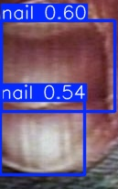
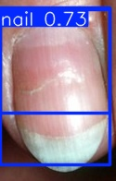
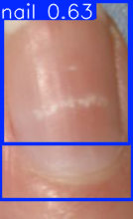
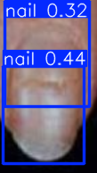
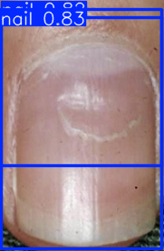
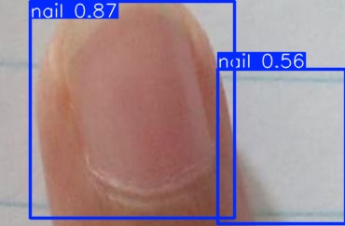
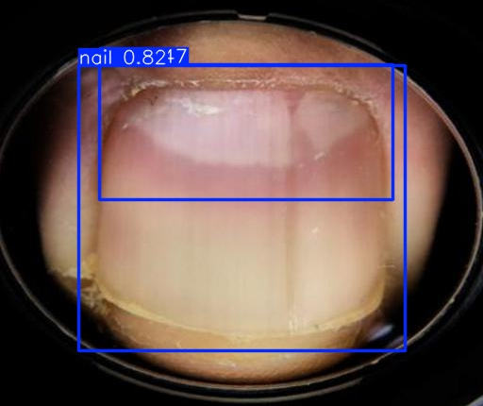
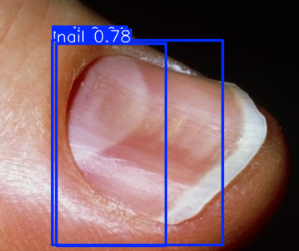
False Positives

Slide 8
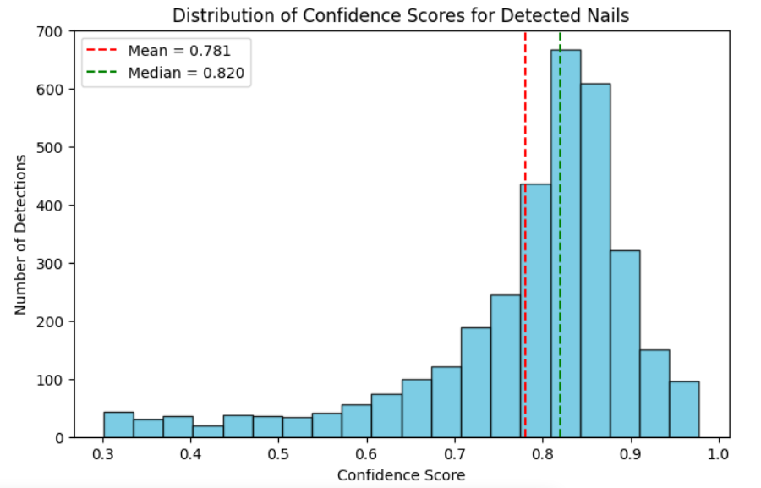
Bounding Box Algorithm: Confidence Score Distribution on the current Dataset
Overall mean confidence: 0.7809
Median confidence: 0.8196
Std deviation: 0.1311

Slide 9
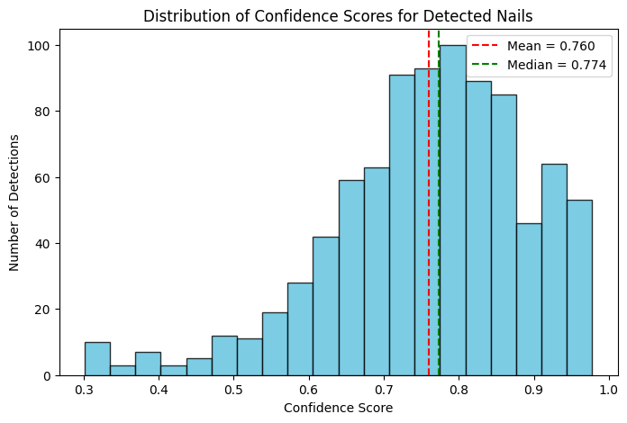
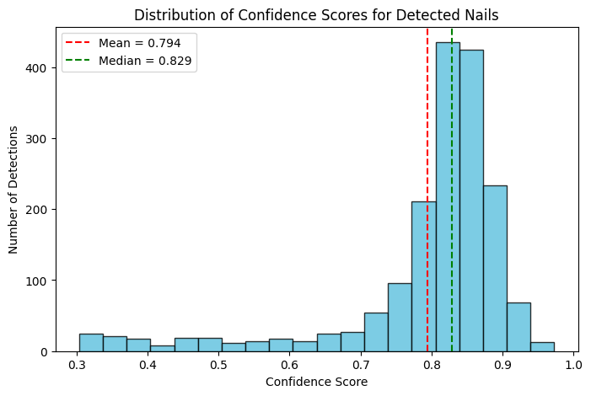
Healthy Other
Overall mean confidence: 0.7601
Median confidence: 0.7735
Overall mean confidence: 0.7938
Median confidence: 0.8286

Slide 10
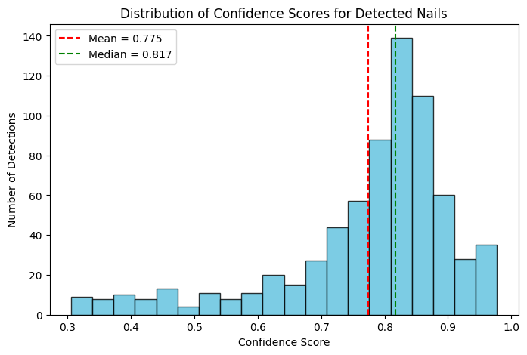
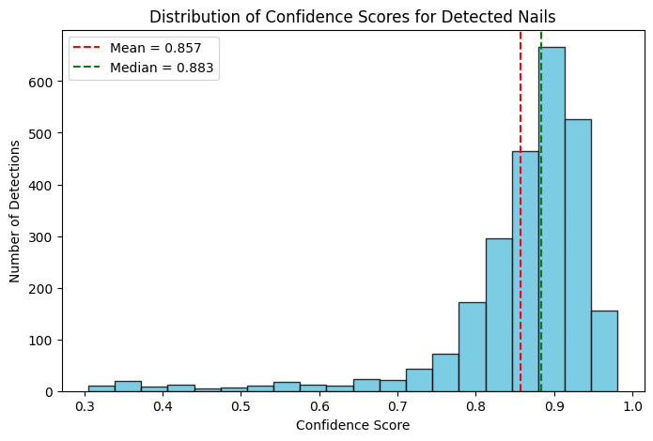
Nail Melanoma Non Melanoma
Overall mean confidence: 0.7756
Median confidence: 0.8171
Overall mean confidence: 0.8576
Median confidence: 0.8834

Slide 11
2. Experimenting with CNN Models: Multi Class Classification
The following CNN models were evaluated on the current dataset, which includes three classes (healthy, melanoma, and other), and their performances were compared.
  Vision Transformer
  YOLO
  ResNet18

Slide 12
Dataset Structure
│── train/
│ │── healthy/
│ │── melanoma/
│ └── other/
│── test/
│ │── healthy/
│ │── melanoma/
│ └── other/
│── val/
│ │── healthy/
│ │── melanoma/
│ └── other/

Slide 13
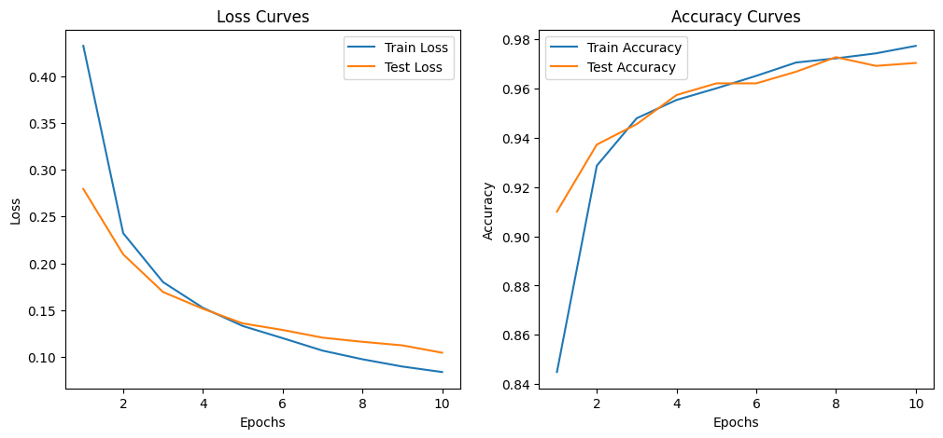
Vision Transformer
Both train and test loss functions descrease steadily → the model is learning well, no sign of overfitting
Both train and test accuracy increase → learning is stable, the model is generalizing well

Slide 14
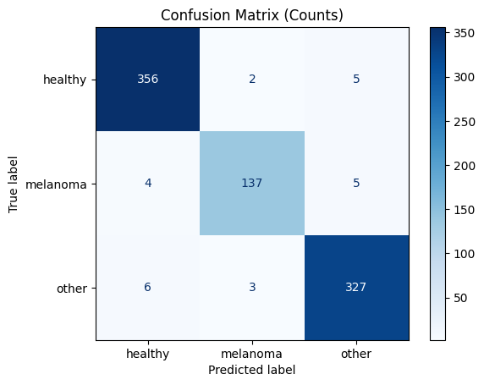
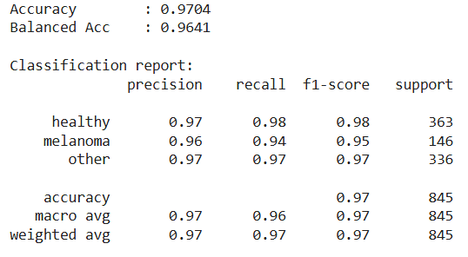
Vision Transformer
The model can accurately distinguish between healthy, melanoma and other diseases.
No severe bias or no major overfitting
The main source of confusion: melanoma cases
All classes have F1-scores above 0.94, showing a great and balanced performance
Melanoma recall (0.94) could be optimized → missing even few cases are medically critical
Conclusion: model achieved a high accuracy

Slide 15
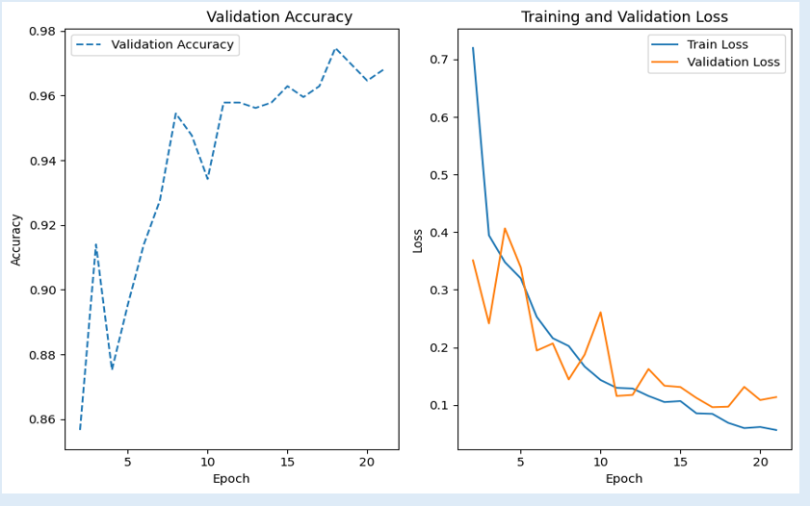
YOLO
validation accuracy function is increasing → model is learning effectively, generalizes well
loss functions are decreasing with epochs
despite of some fluctuations in the validation loss, the steady decrease is a sign of learning

Slide 16
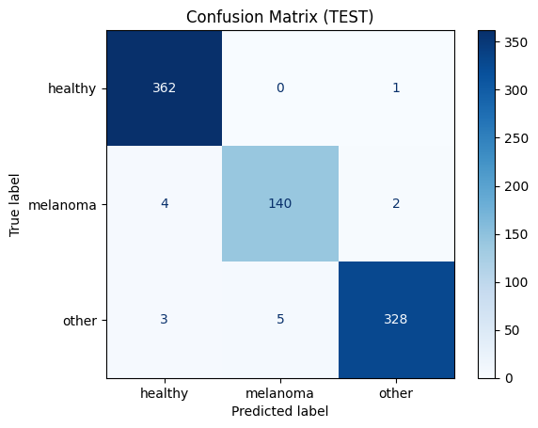
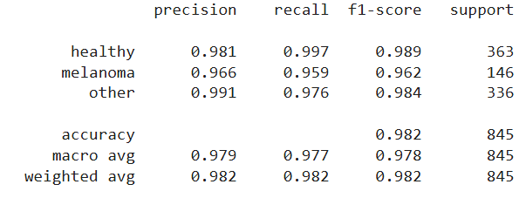
YOLO
healthy nails: almost perfect classification
melanoma nails: a few were misclassified
other nails: strong performance
All three classes have high F1-scores
Melanoma class has slightly lower recall
Conclusion: model makes accurate decisions and generalizes well. The few missed melanoma cases should be examined.

Slide 17
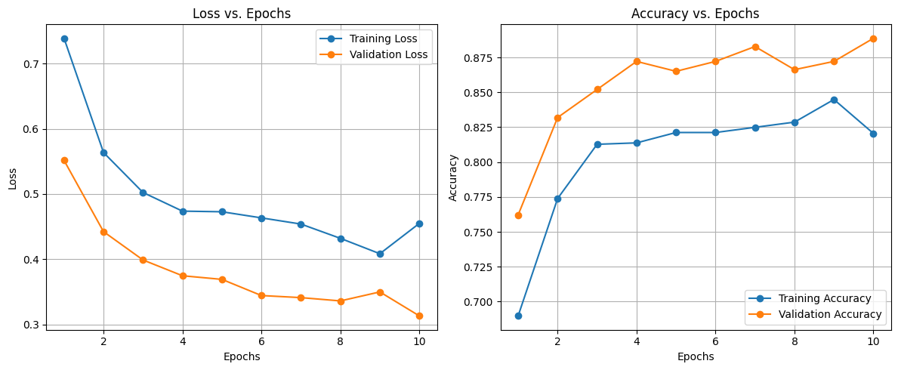
ResNet18
training loss starts high and decreases slowly
validation loss starts lower and decreases more sharply and stays consistently below training loss → might be a sign of underfitting, model has not learnt enough
training accuracy is improving with epochs
validation accuracy is increasing as well, and it stays always higher than training accuracy → indicates to underfitting

Slide 18
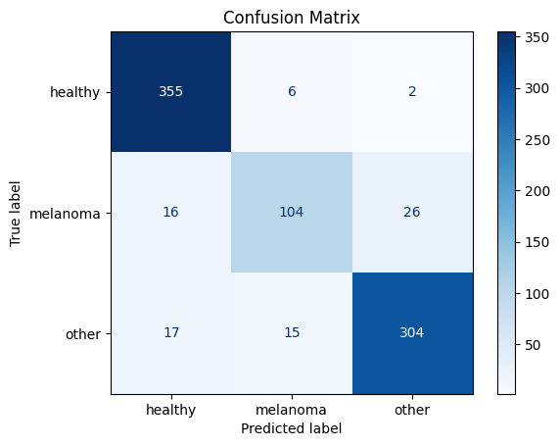
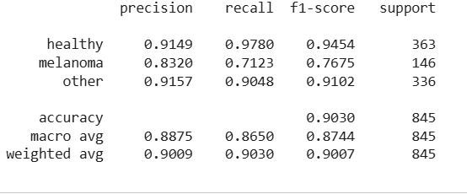
ResNet18
the model classifies healthy and other cases accurately
but it confuses melanoma with other classes
possible causes:
  dataset imbalance
  visual overlap between nail disorders
  low number of epochs,
  insufficient choice of hyperparameters
Conclusion: Model‘s overall accuracy is not bad, it shows a strrong performance for healthy and other cases. But it has a lower recall for melanoma samples → should be further improved

Slide 19
3. Binary Classification
For the binary classification task, the healthy and other classes were merged into a single class called “non-melanoma”, while the melanoma class remained unchanged.
The CNN models were then evaluated using two classes: melanoma and non-melanoma.
│── train/
│ │── melanoma/
│ └── non melanoma/
│── test/
│ │── melanoma/
│ └── non melanoma/
│── val/
│ │── melanoma/
│ └── non melanoma/

Slide 20
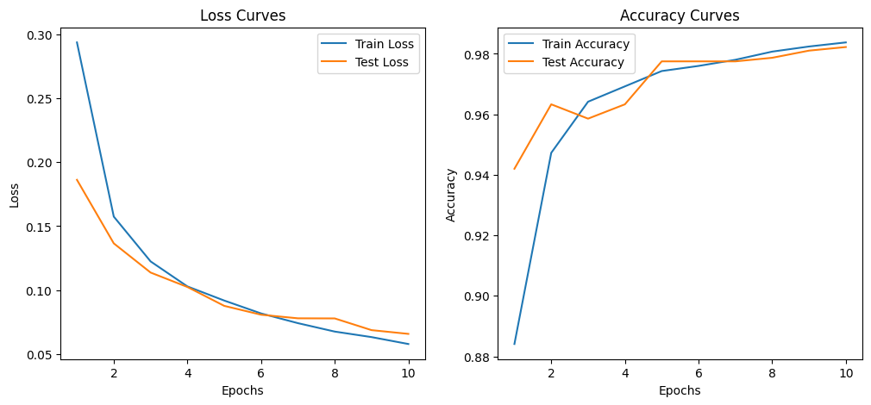
Vision Transformer
both train and test loss functions drop steadily → model is learning effectively
both accuracy curves are rising → strong performance, no sign of overfitting

Slide 21
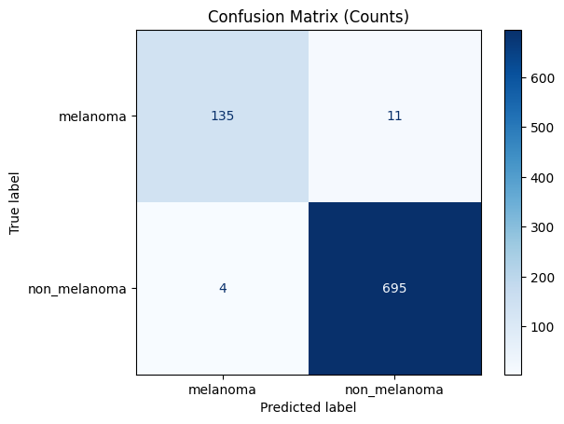
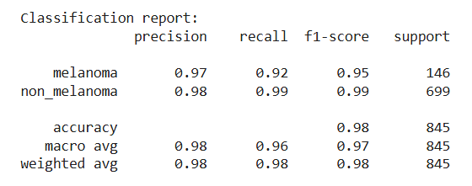
Vision Transformer
the model performs very well at identifying both classes
the few misclassiffications are minimal
the slightly higher number of false positives are important
the model reached a high F1-Score for both classes → good balance
Conclusion: the model generalizes well and achieves a high accuracy in the melanoma detection, however melanoma recall should be improved

Slide 22
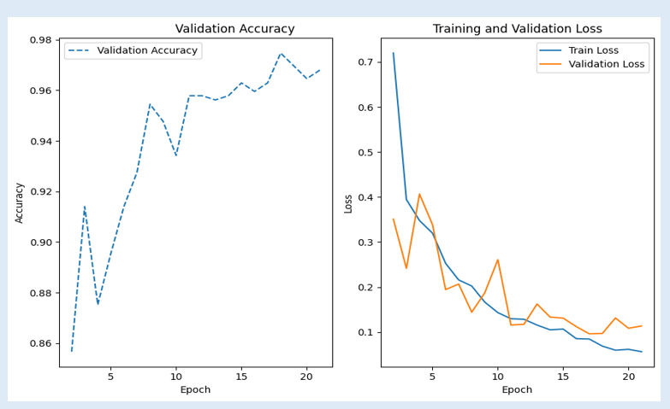
YOLO
accuracy curve is rising → model is learning
both training and validation loss curves drop steadily → model is minimizing its errors

Slide 23
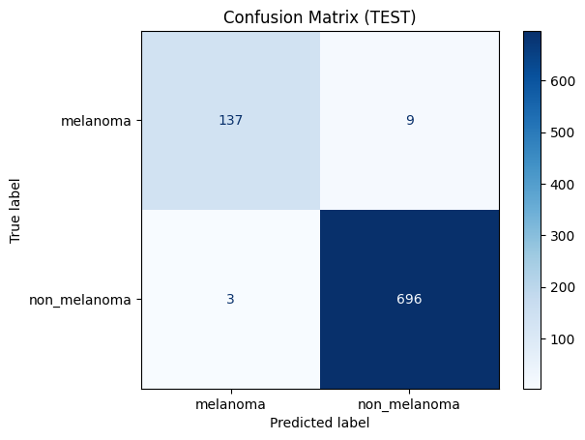
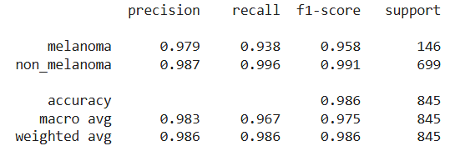
YOLO
the model is highly accurate across both classes
melanoma recall is slighty lower than non-melanoma recall
Conclusion: model is highly reliable and generalizes well, since it missed a few samples only. It is suitable for the medical classification task, but melanoma recall should be enhanced.

Slide 24
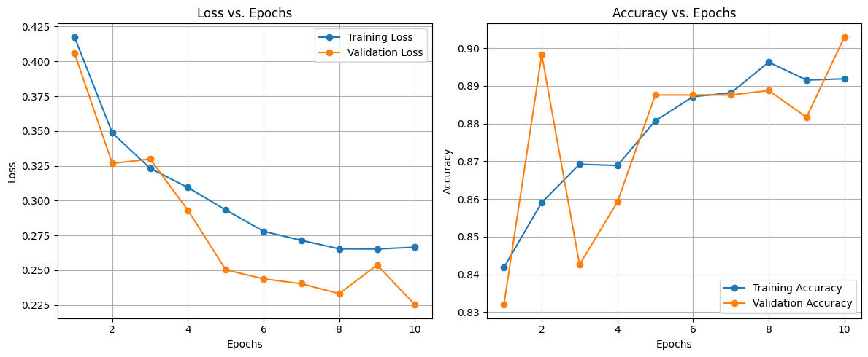
ResNet18
both training and validation loss functions are decreasing over time, but validation loss is consistently higher than training loss → might be sign of underfitting, model has not learnt enough from the training set
both training and validation accuracy are increasing gradually, even though validation accuracy fluctuates in the beginning
the model is learning, but relatively modest accuracy suggests underfitting

Slide 25
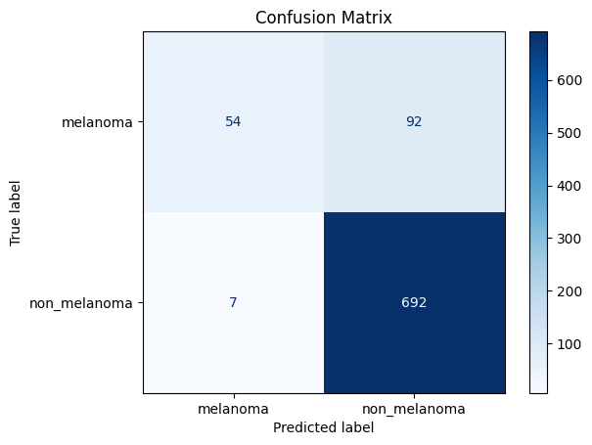
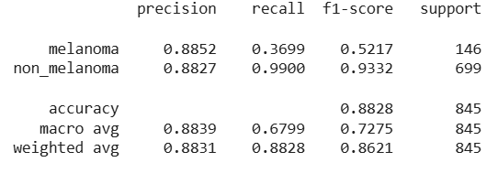
ResNet18
the model detects non-melanoma cases very accurately.
but it misses most of the melanoma cases → model learnt the majority class
this is a sign of class imbalance or insufficiant learning of the model
Conclusion: model is reliable for detecting non-melanoma samples but for melanoma detection it isn‘t accurate. It is not adequate for medical use

Slide 26
Performance Comparison of the CNN Models: 1. Multi-Class Classification
Model | Classes | Precision | Recall | F1-Score | Accuracy
Vision Transformer | healthy: melanoma: other: | 0,97 0,96 0,97 | 0,98 0,94 0,97 | 0,98 0,95 0,97 | 0,97
YOLO | healthy: melanoma: other: | 0,98 0,96 0,99 | 0,99 0,95 0,97 | 0,98 0,96 0,98 | 0,98
ResNet18 | healthy: melanoma: other: | 0,91 0,83 0,91 | 0,97 0,71 0,90 | 0,94 0,76 0,91 | 0,90
YOLO achieves the highest overall accuracy and slightly outperforms Vision Transformer

Slide 27
2. Binary Classification
Model | Classes | Precision | Recall | F1-Score | Accuracy
Vision Transformer | melanoma: non melanoma: | 0,97 0,98 | 0,92 0,99 | 0,95 0,99 | 0,98
YOLO | melanoma: non melanoma: | 0,97 0,98 | 0,93 0,99 | 0,95 0,99 | 0,98
ResNet18 | melanoma: non melanoma: | 0,88 0,88 | 0,36 0,99 | 0,52 0,93 | 0,88
Both Vision Transformer and YOLO achieved a strong performance, while melanoma recall of YOLO is slightly better than Vision Transformer

Slide 28
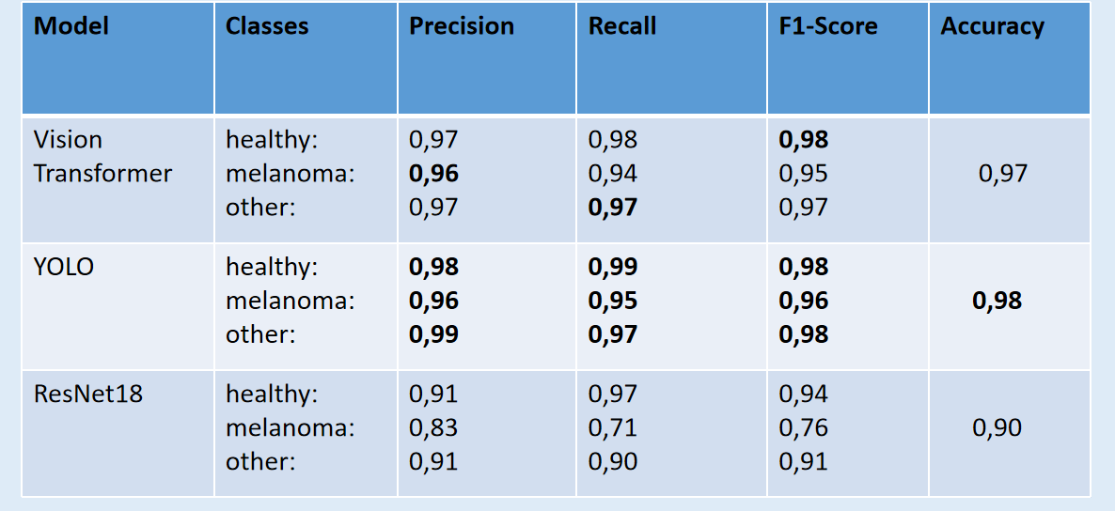
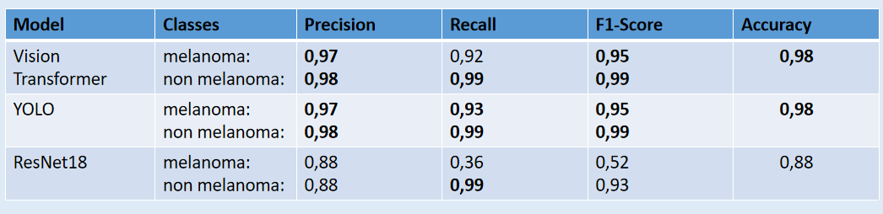
Multi-Class vs. Binary
Accuracy stayed roughly the same (0,97-0,98), merging classes didn‘t change overall performance
However melanoma recall decreases slightly, models became less sensitive to melanoma cases → simplifying the problem didn‘t necessarily improve melanoma detection
YOLO showed consistently the best performance in the both setups
Vision Transformer performed nearly equally well with YOLO and offers better explainibility potential (with self attention mechanism)
ResNet18 shows clear underfitting and bias to non-melanoma class in both setups
Improving melanoma detection is the main challenge

